Slide 1

AUTOSAR

Slide 2
Agenda
PART - 1
CLASSIC AUTOSAR
PART – 2
ADAPTIVE AUTOSAR

Slide 3
PART-1
CLASSIC AUTOSAR

Slide 4






AUTOSAR Tools
Companies | BSW Configurator | RTE Generator | SWC System Tooling
 | DaVinci Configurator Pro | RTE Generator | Davinci Developer
 | Volcano VSTAR | Volcano VSTAR | Volcano VSTAR
 | EB Tresos Studio | EB Tresos Studio | -
 | ISOLAR – B | RTA- RTE | ISOLAR - A
 | Arctic Studio | Arctic Studio | Arctic Studio
 | K-SAR Editor | K-SAR Editor | K-SAR Editor

Slide 5





Vector AUTOSAR Tools
Vector Davinci Configurator – To Configure BSW Module (e.g : CAN, CanIf, Com, Os, Dem)
Vector Davinci Developer – To Configure Application & Service software components (SWC’s)
Vector Dbc++ – To Edit and Preview the Communication Database.
Vector License Administrator – To manage the licensing of above tools
Vector Canoe – Testing tool

Slide 6
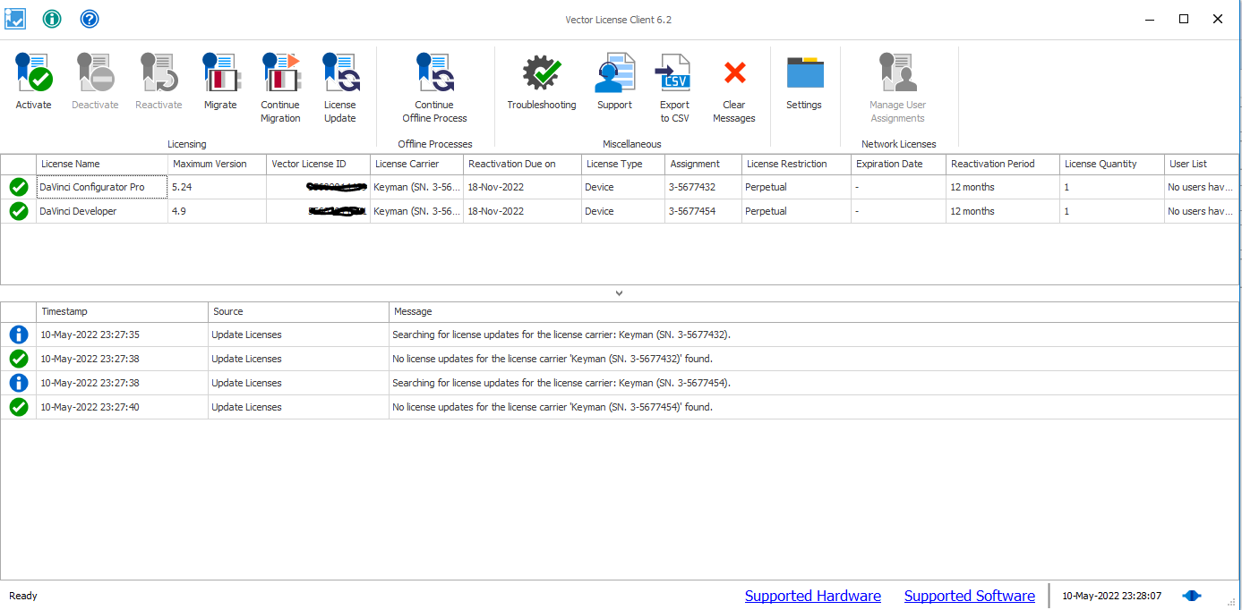
Vector license Client

Slide 7
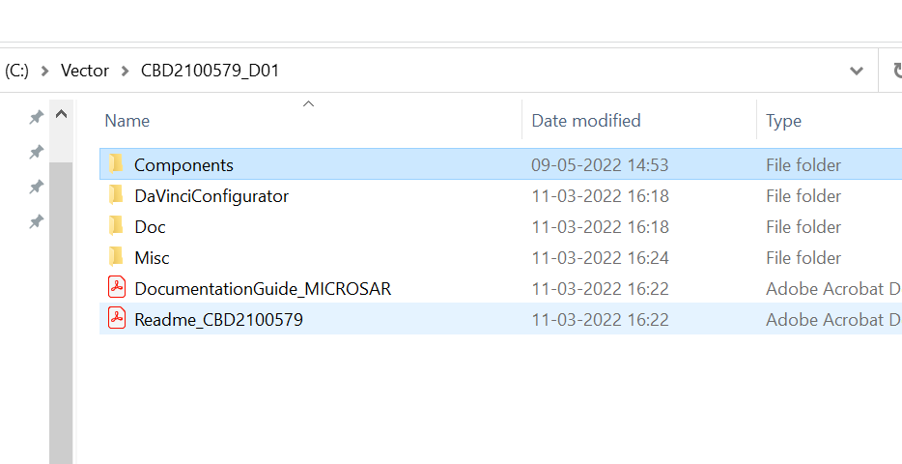
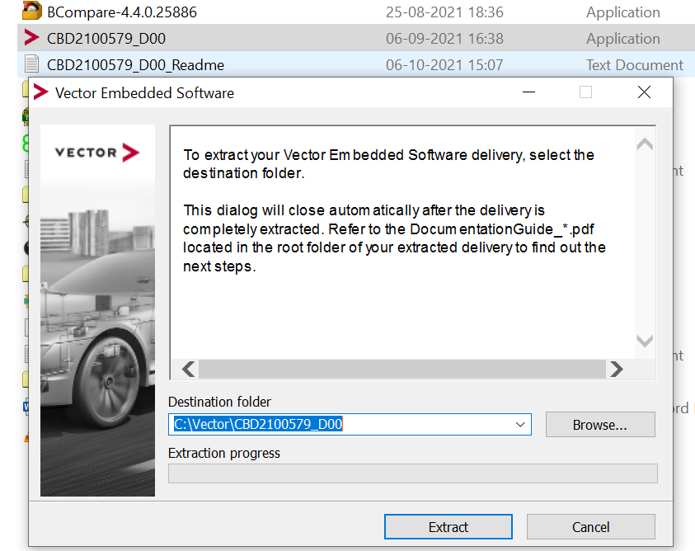
Vector SIP(Stack & Module Definition file)
SIP Extraction:
SIP Folder Structure:
- MICROSAR is the AUTOSAR solution from Vector for ECU software.
MICROSAR consists of the MICROSAR. RTE and MICROSAR basic software modules (BSW), which cover all aspects of the AUTOSAR standard and many extensions.
Each AUTOSAR BSW module is assigned to a MICROSAR package.

Slide 8
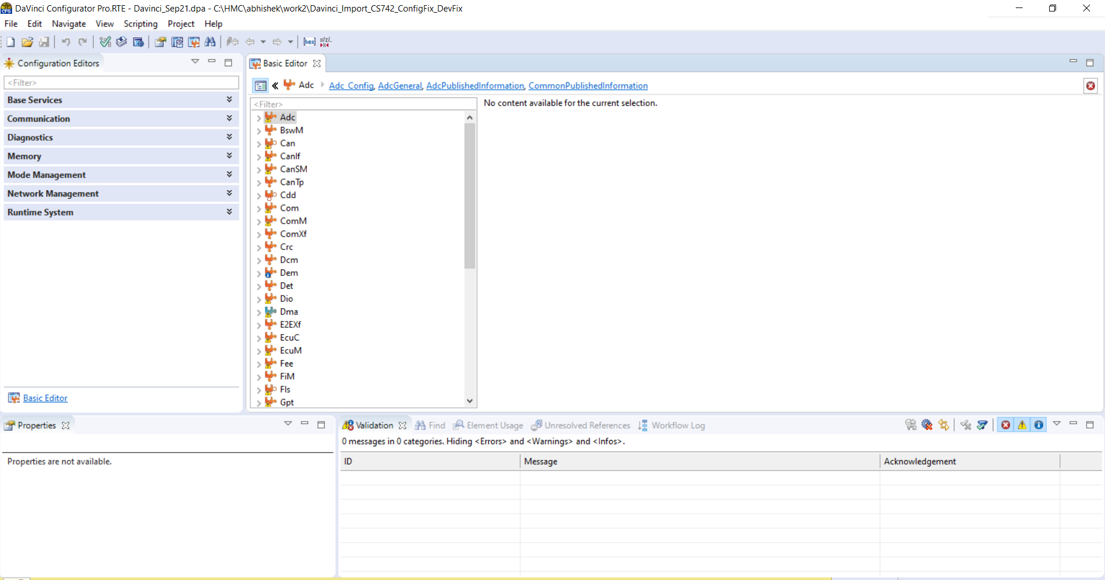
Interface of Davinci Configurator

Slide 9
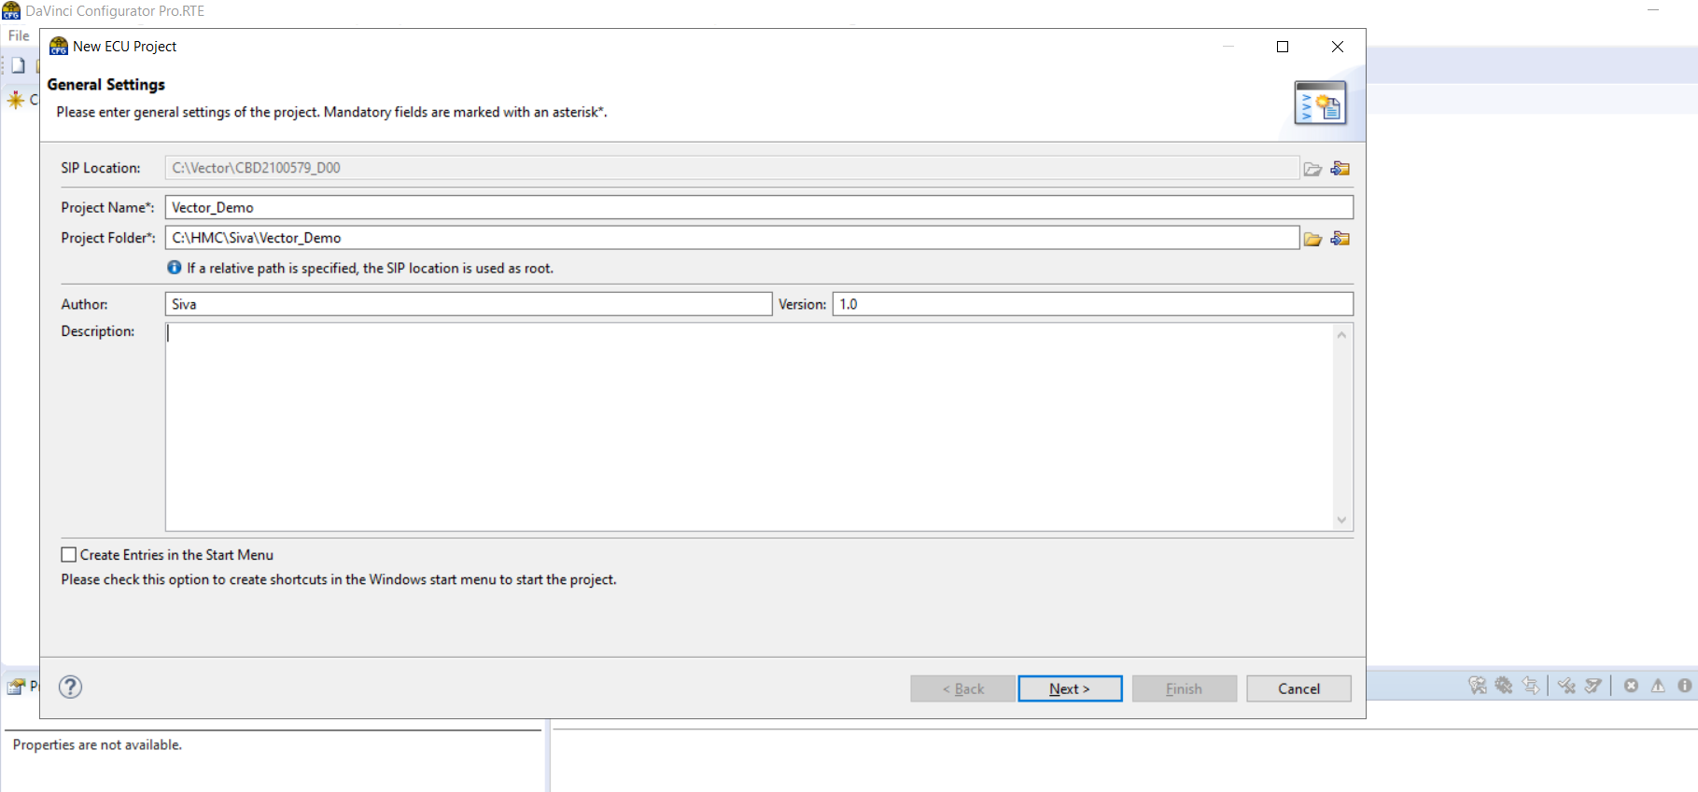
Creating New Project – From Scratch
File -> New ECU Project

Slide 10
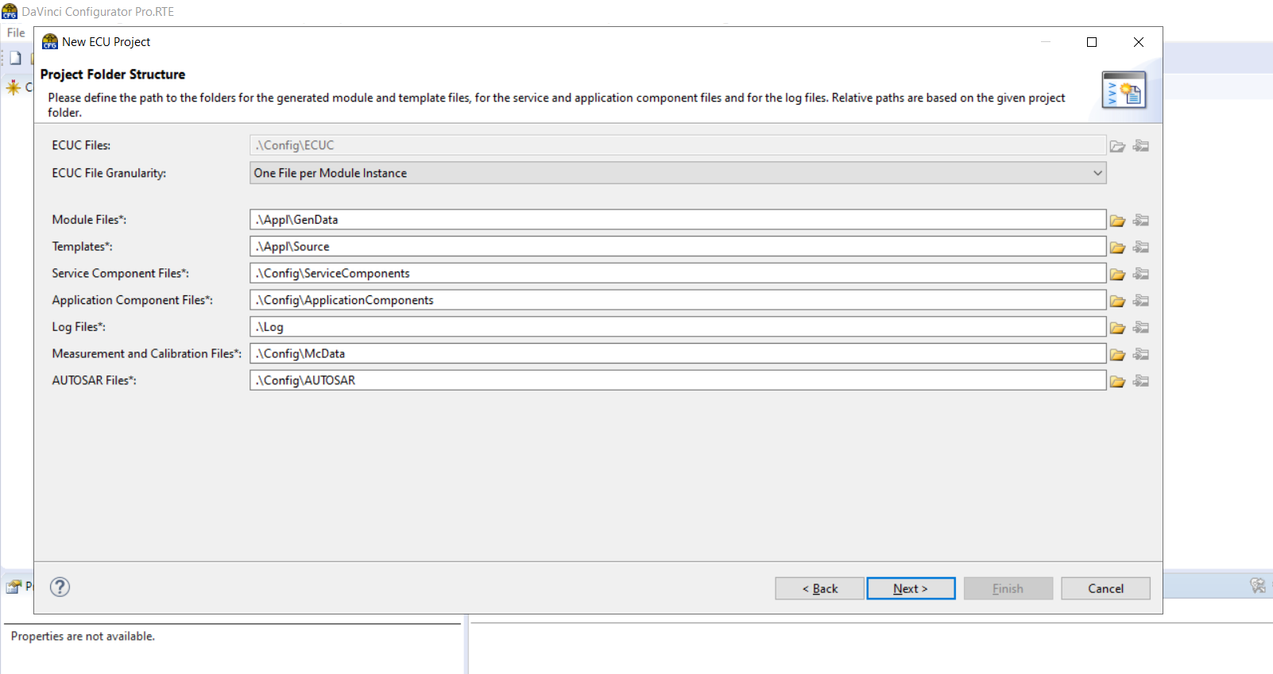
Folder Structure

Slide 11
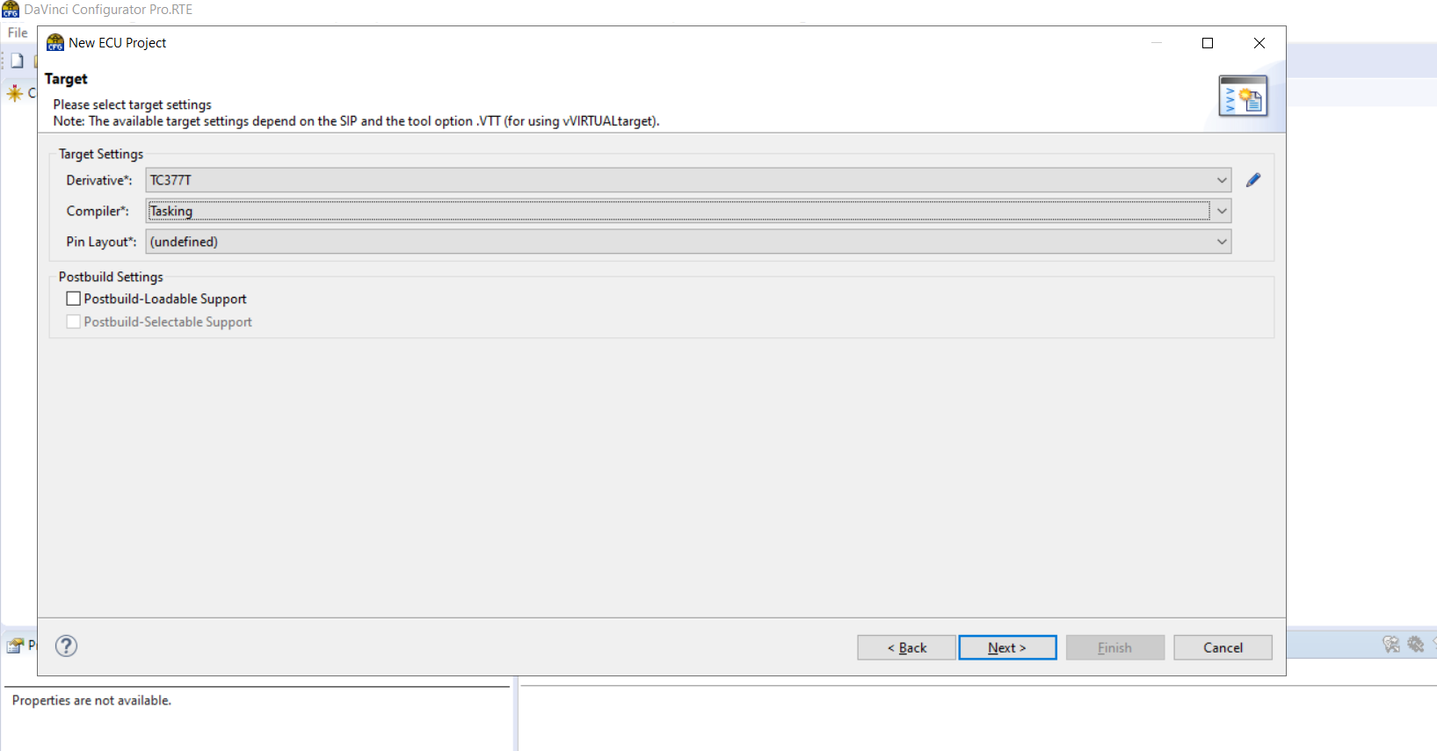
Target Selection

Slide 12
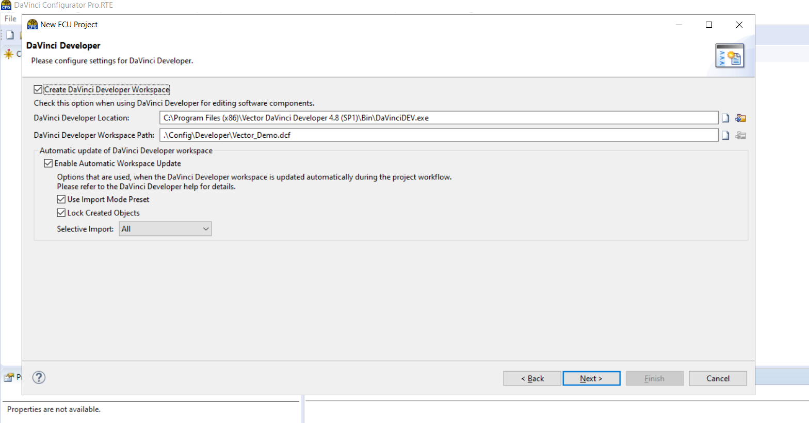
Developer Setting

Slide 13
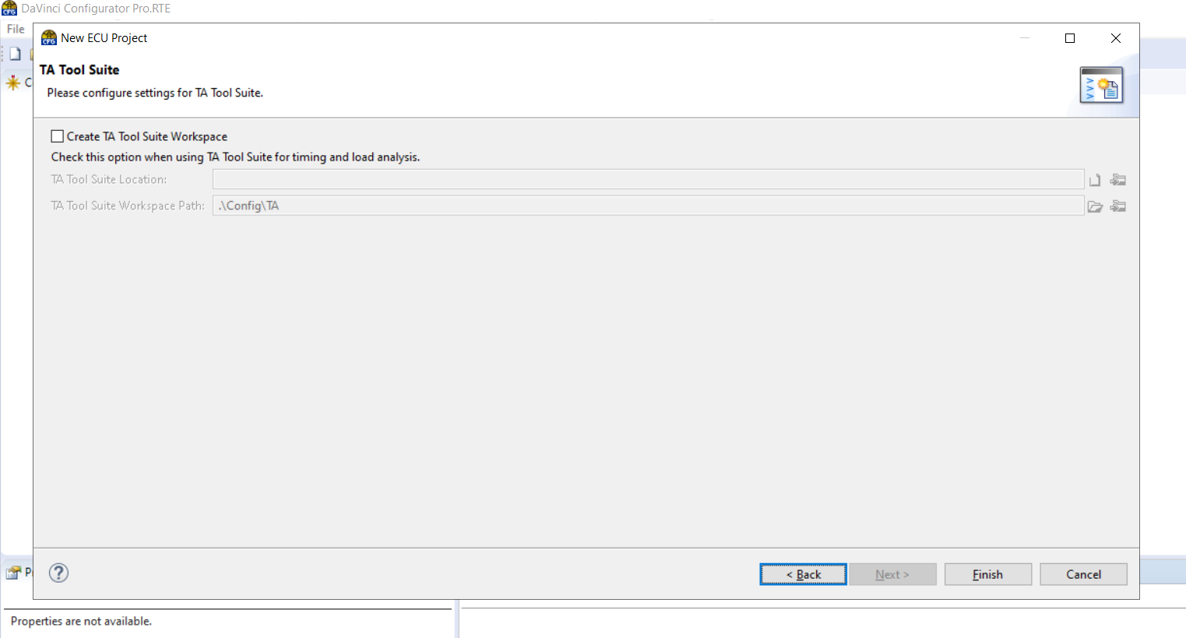
TA Tool Suite

Slide 14

New Project GUI

Slide 15
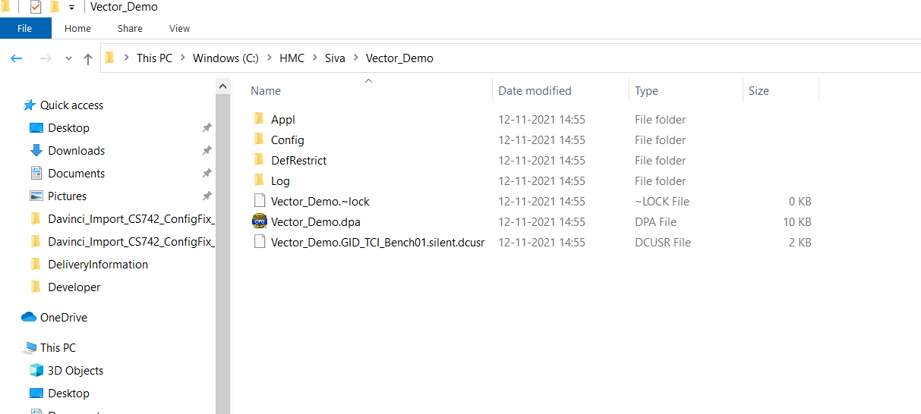
Workspace Structure

Slide 16


Input Files & Importing Process
ECU Extract(.arxml)
Module Definition file
Stack File
.c and .h
DBC(.dbc)
Generated .c and .h Files
.exe File
Add New Bsw Modules
Compilation
Process
Configuration Tool
Import existing BSW_XXX.arxml
Vector Specific Files & Tools
Import Existing Project .dpa
Application SWC’s(.arxml)
Generic File

Slide 17
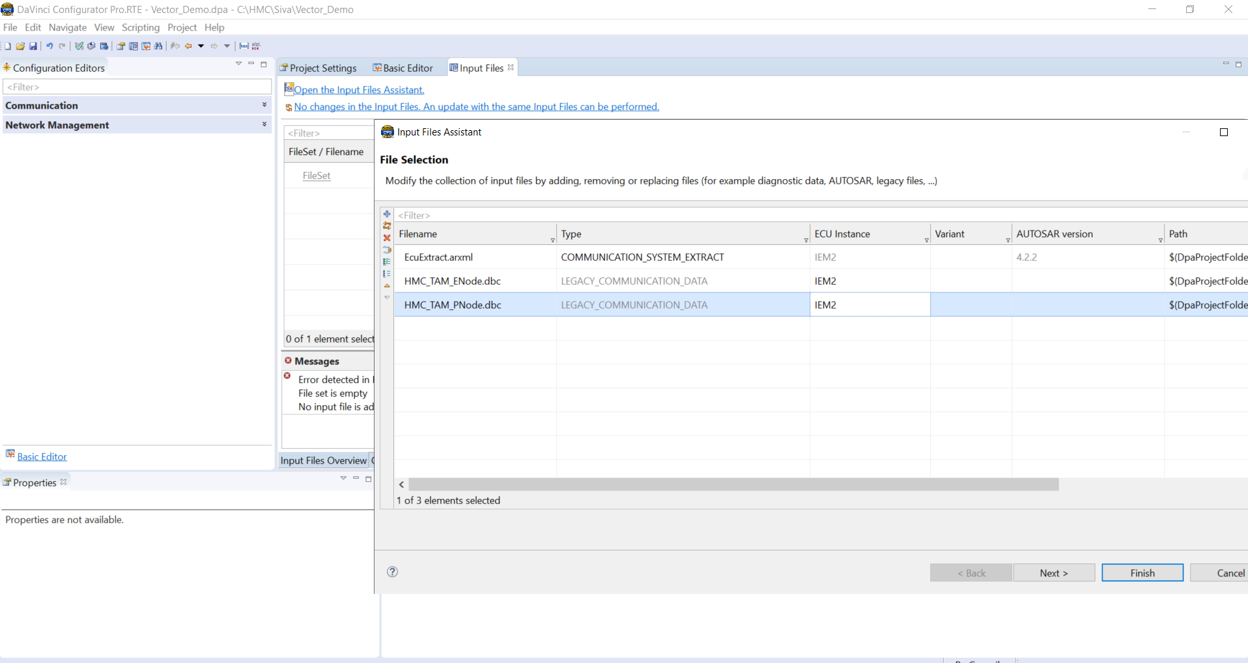
Importing System Description & dbc Files
Project-> Project setting

Slide 18
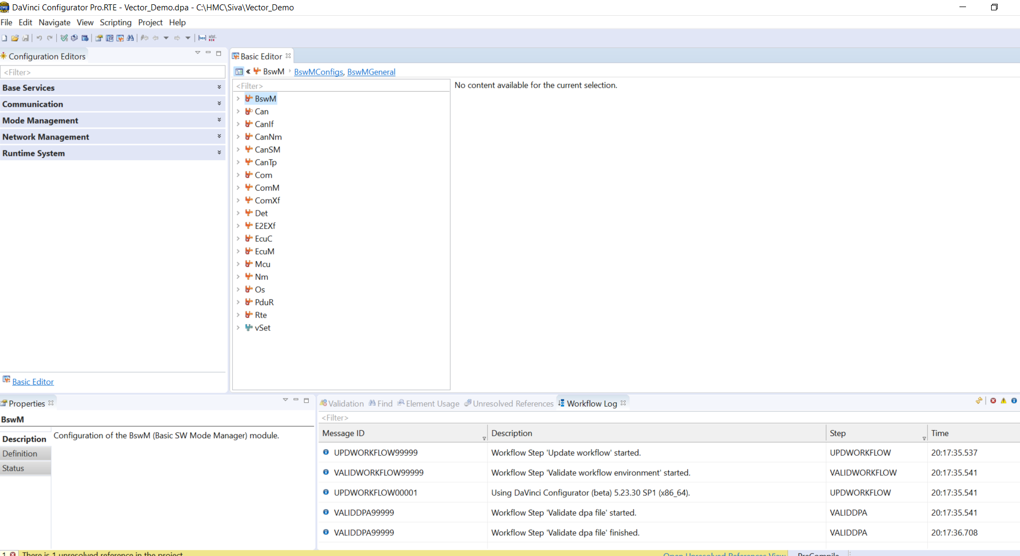
After Import
Project-> Project setting

Slide 19
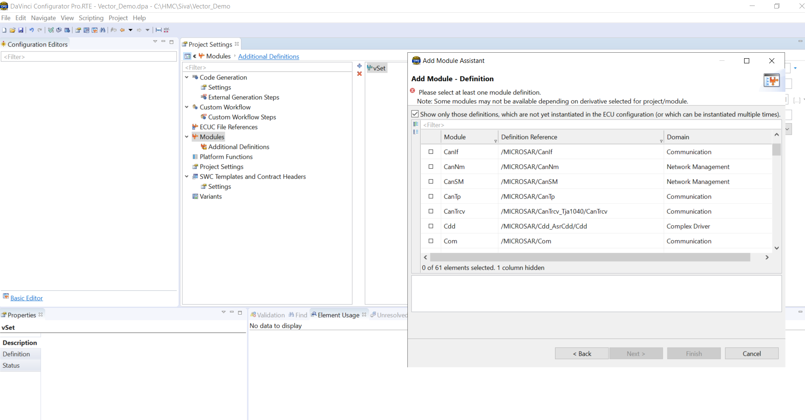
Adding New MICROSAR BSW Modules
Project-> Project Settings-> Modules -> Add Modules

Slide 20
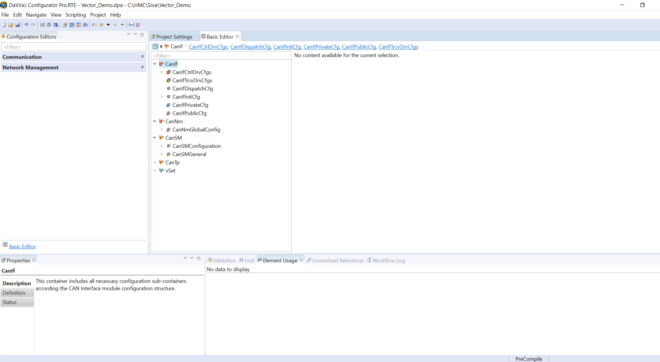
After Adding New MICROSAR Module

Slide 21
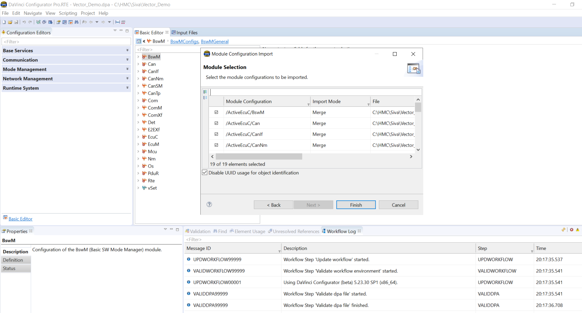
Import Existing Project File
File-> Import (.dpa, .arxml)

Slide 22
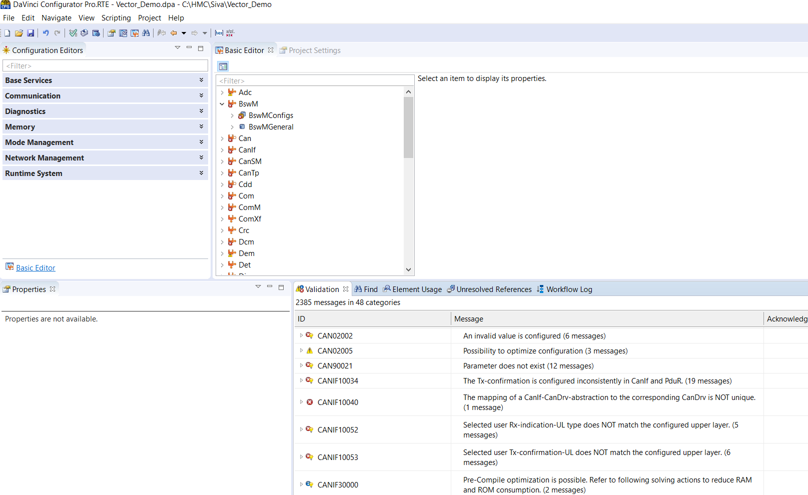
Errors After Import

Slide 23
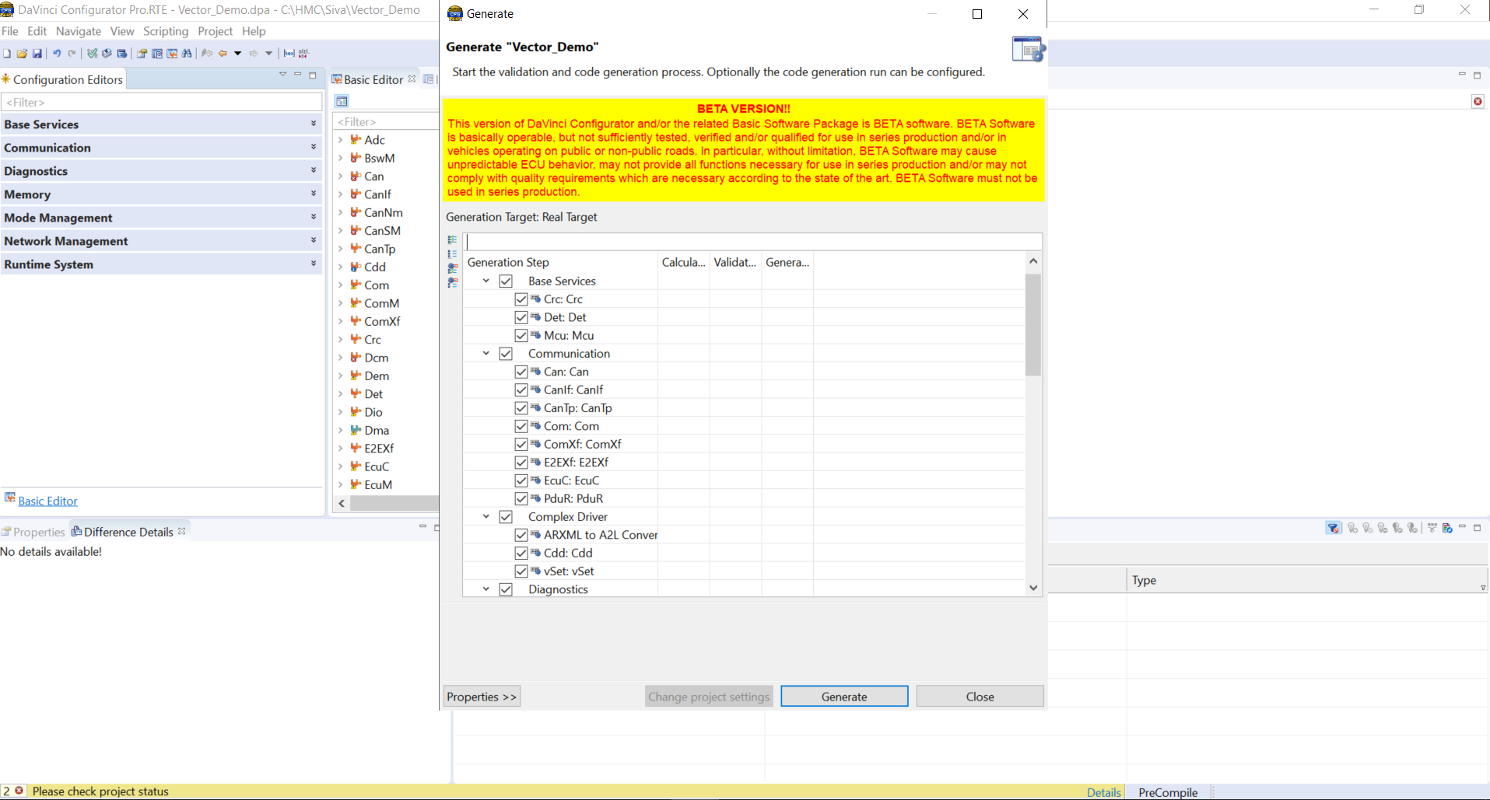
Generating code in Davinci Configurator

Slide 24
PART-2
ADAPTIVE AUTOSAR

Slide 25
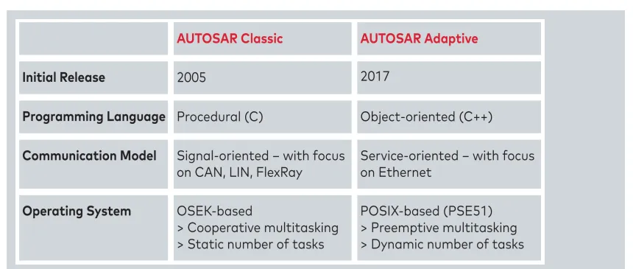
ADAPTIVE AUTOSAR introduction
Adaptive Platform enables the dynamic linking of services and clients during runtime.
Adaptive AUTOSAR is an extension of the widely used AUTOSAR (Automotive Open System ARchitecture) standard, which is an open and standardized software architecture for automotive electronics. Adaptive AUTOSAR is designed to meet the needs of highly complex and highly integrated electronic systems in modern vehicles, such as autonomous driving, advanced driver assistance systems (ADAS), and connected car features.
Adaptive AUTOSAR is designed to be more flexible and scalable than the traditional AUTOSAR architecture. It supports a more modular and distributed approach to software development, which allows developers to quickly and easily integrate new functionality and features. It also provides a more dynamic and configurable platform, which can adapt to changing requirements and environments.

Slide 26
ADAPTIVE AUTOSAR introduction
What is Adaptive AUTOSAR:
a standardized middleware/architecture definition of automotive software for future high performance computing ECUs. It does not define a concrete design/implementation like Classic AUTOSAR but leave a certain degree of freedom for the development.
→ Internal interfaces between the building blocks of the AUTOSAR Adaptive Platform shall not be standardized.
Adaptive AUTOSAR Platform address following software building block functions over a POSIX base Operating System:
Runtime: Execution Management, State Management, Log and Trace, Core, OS Interface.
Communication: Communication Management, Time Synchronization, Raw Data Stream, Network Management.
Storage: Persistency.
Safety: Platform Health Management.
Security: Cryptography, Intrusion Detection System Manager, Firewall.
Diagnostic: Diagnostic Management.
Configuration: Update and Configuration Management, Vehicle Update and Configuration Management, Registry.

Slide 27
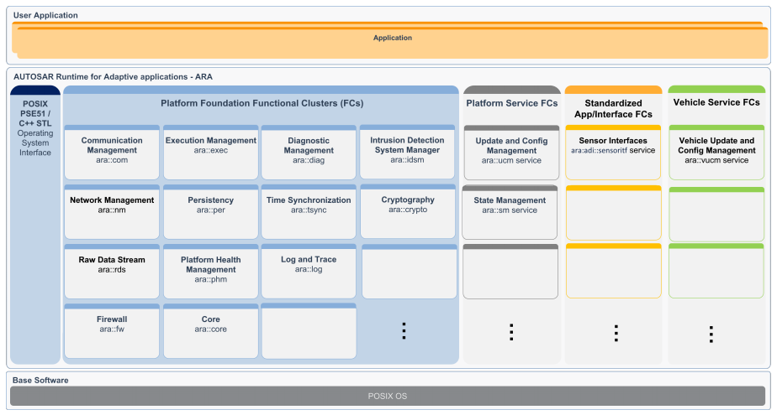
ADAPTIVE AUTOSAR introduction
Adaptive Application[AA]: user-level component that implements most of the project/ECU specific functionalities, and run on top of the environment(ara), which is provided by Platform components(FC).
Functional Clusters[FC]: logical group of functionality, sub-component of above building blocks(2nd level of abstraction). Could be implemented as a library or processes (Library-based or Service based), which belong to either Adaptive Platform Foundation, Adaptive Platform Services, Standard Application/Interfaces or Vehicle Services.
Adaptive Platform[AP] Foundation: group of Functional Cluster that provide fundamental functionalities
Adaptive Platform Service: group of FC that provide standardized services

Slide 28
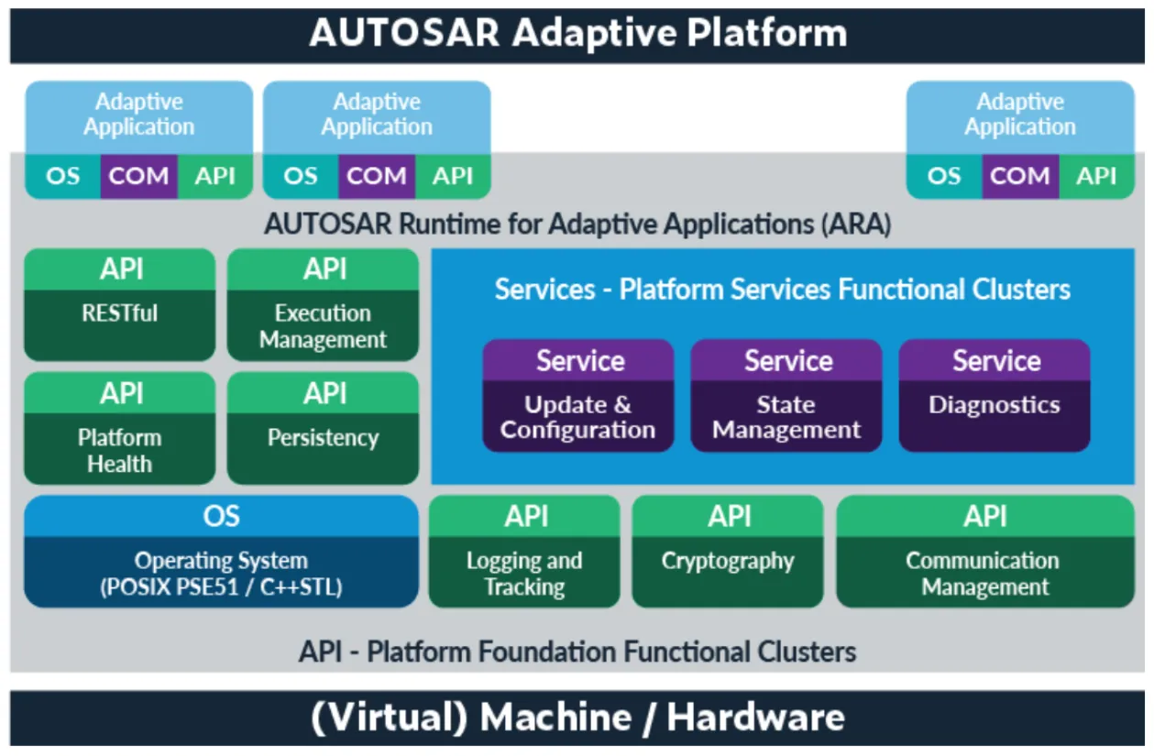
ADAPTIVE AUTOSAR introduction
One of the key features of Adaptive AUTOSAR is its ability to support over-the-air (OTA) software updates, which enable manufacturers to remotely update software in vehicles without requiring physical access to the vehicle. This is an important feature for ensuring that vehicles remain up-to-date with the latest software and security patches.
Adaptive AUTOSAR also provides a standardized framework for managing software functions and features across different domains and subsystems within a vehicle. This enables manufacturers to develop and integrate new features more quickly and efficiently, while also improving overall system reliability and performance.
Overall, Adaptive AUTOSAR is a key technology for the development of next-generation automotive systems, enabling manufacturers to build safer, more reliable, and more connected vehicles that meet the demands of today’s fast-evolving automotive market.

Slide 29
ADAPTIVE AUTOSAR UseCase
Use Cases for Adaptive Autosar
Autosar (Automotive Open System Architecture) is a software architecture standard that is widely used in the automotive industry to develop software for electronic control units (ECUs) in vehicles. Adaptive Autosar is an extension of the standard Autosar, which is designed to support the development of more complex and advanced systems that require more flexibility and adaptability. Here are some use cases for Adaptive Autosar:
Autonomous driving: Adaptive Autosar can be used to develop software for autonomous driving systems. These systems require a high level of flexibility and adaptability, as they need to respond to changing road conditions and unexpected events in real time.
Connected vehicles: Adaptive Autosar can be used to develop software for connected vehicles that can communicate with other vehicles, infrastructure, and the cloud. These systems require a high degree of flexibility and adaptability, as they need to work with different types of communication protocols and devices.
Advanced driver assistance systems (ADAS): Adaptive Autosar can be used to develop software for ADAS systems that provide advanced safety features such as lane departure warnings, adaptive cruise control, and automatic emergency braking. These systems require a high level of flexibility and adaptability, as they need to respond to changing road conditions and unexpected events in real time.
Electric vehicles: Adaptive Autosar can be used to develop software for electric vehicles that manage the battery, motor, and charging systems. These systems require a high degree of flexibility and adaptability, as they need to manage the complex interactions between the battery, motor, and charging systems.
Infotainment systems: Adaptive Autosar can be used to develop software for infotainment systems that provide entertainment, communication, and navigation features to the driver and passengers. These systems require a high level of flexibility and adaptability, as they need to work with different types of media, devices, and interfaces.
Overall, Adaptive Autosar can be used in any situation where a high degree of flexibility and adaptability is required to develop complex and advanced automotive systems.

Slide 30
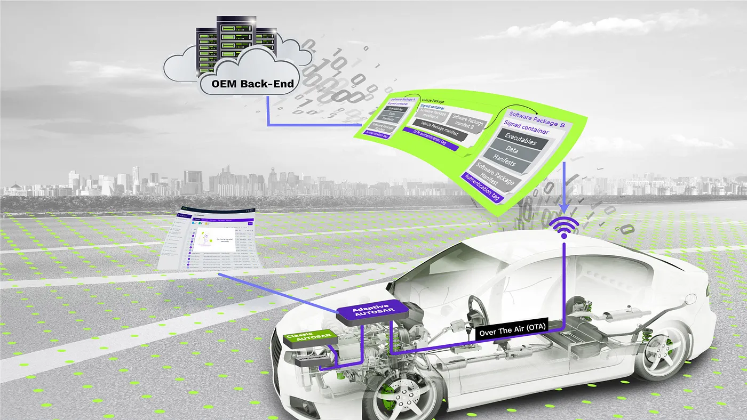
ADAPTIVE AUTOSAR UseCase
Updates and Upgrades
One of the most significant differences to AUTOSAR Classic: AUTOSAR Adaptive tears down the separation between design time and execution time.
Current automotive trends like autonomous driving or car-to-x services demand the flexibility that consumers know from their PC or smartphone:
software updates over the air (OTA),
applications that can be installed to enhance the functionality of the system
applications that communicate with services outside the vehicle.
The AUTOSAR Adaptive platform allows the integration of new applications at any time.

Slide 31
ADAPTIVE AUTOSAR basic principle
Overall view and basic principles
Adaptive AUTOSAR is an automotive software architecture that is designed to support the development of software for high-performance and safety-critical applications in modern vehicles. It is an evolution of Classic AUTOSAR, which was primarily used for traditional embedded systems in vehicles.
The main principles of Adaptive AUTOSAR include:
Modularity: Adaptive AUTOSAR is designed to be modular, with software components that can be easily configured and combined to create complex applications.
Scalability: Adaptive AUTOSAR supports a wide range of hardware platforms, from low-end microcontrollers to high-performance processors, and can scale from small embedded systems to complex distributed systems.
Safety and Security: Adaptive AUTOSAR includes features that support the development of safety-critical and security-critical systems, including functional safety, cybersecurity, and secure communication.
Flexibility: Adaptive AUTOSAR allows for flexible software updates and reconfiguration, enabling the development of software that can adapt to changing requirements and conditions.
Interoperability: Adaptive AUTOSAR is designed to support interoperability between different software components and systems, enabling the development of complex, distributed systems.
Overall, Adaptive AUTOSAR aims to provide a flexible and scalable software architecture that can support the development of advanced and complex systems in modern vehicles, while ensuring safety, security, and interoperability.

Slide 32
ADAPTIVE AUTOSAR Methedology
Methodology and workflow
The methodology and workflow of Adaptive AUTOSAR involve several stages, including:
Requirements engineering: In this stage, the requirements for the system are defined and documented, including functional, non-functional, and safety requirements.
Architecture design: Based on the requirements, the system architecture is designed, including the allocation of functions to software components, the definition of communication interfaces, and the selection of hardware platforms.
Software component design: In this stage, the software components are designed and implemented, including the definition of the component interfaces, the implementation of the component logic, and the testing of the component.
Integration and testing: The software components are integrated into the system and tested, including functional testing, performance testing, and safety testing.
Configuration and deployment: The software components are configured for the specific hardware platform and deployed to the target system.
Maintenance and evolution: The system is monitored and maintained over time, and updates and changes are made as needed to meet changing requirements or address issues.
Adaptive AUTOSAR follows a model-based development approach, where the system and software design are created using models that can be simulated and validated before implementation. This approach allows for early detection of design issues and can reduce the time and cost of development.

Slide 33
ADAPTIVE AUTOSAR Methedology
Adaptive AUTOSAR Development Methodology
AUTOSAR_AP_TR_Methodology
Development methodology is a common technical approach (i.e. development steps and corresponding outputs) Adaptive AUTOSAR development methodology is built upon the existed Classic Platform (an extension without re-invent the wheel).
what are development activities?
OEM: define vehicle function architecture
Tier1: develop and integrate ECUs with CP, AP or mixed CP/AP or non-AUTOSAR
Other supplier: develop platform or specific component softwares

Slide 34
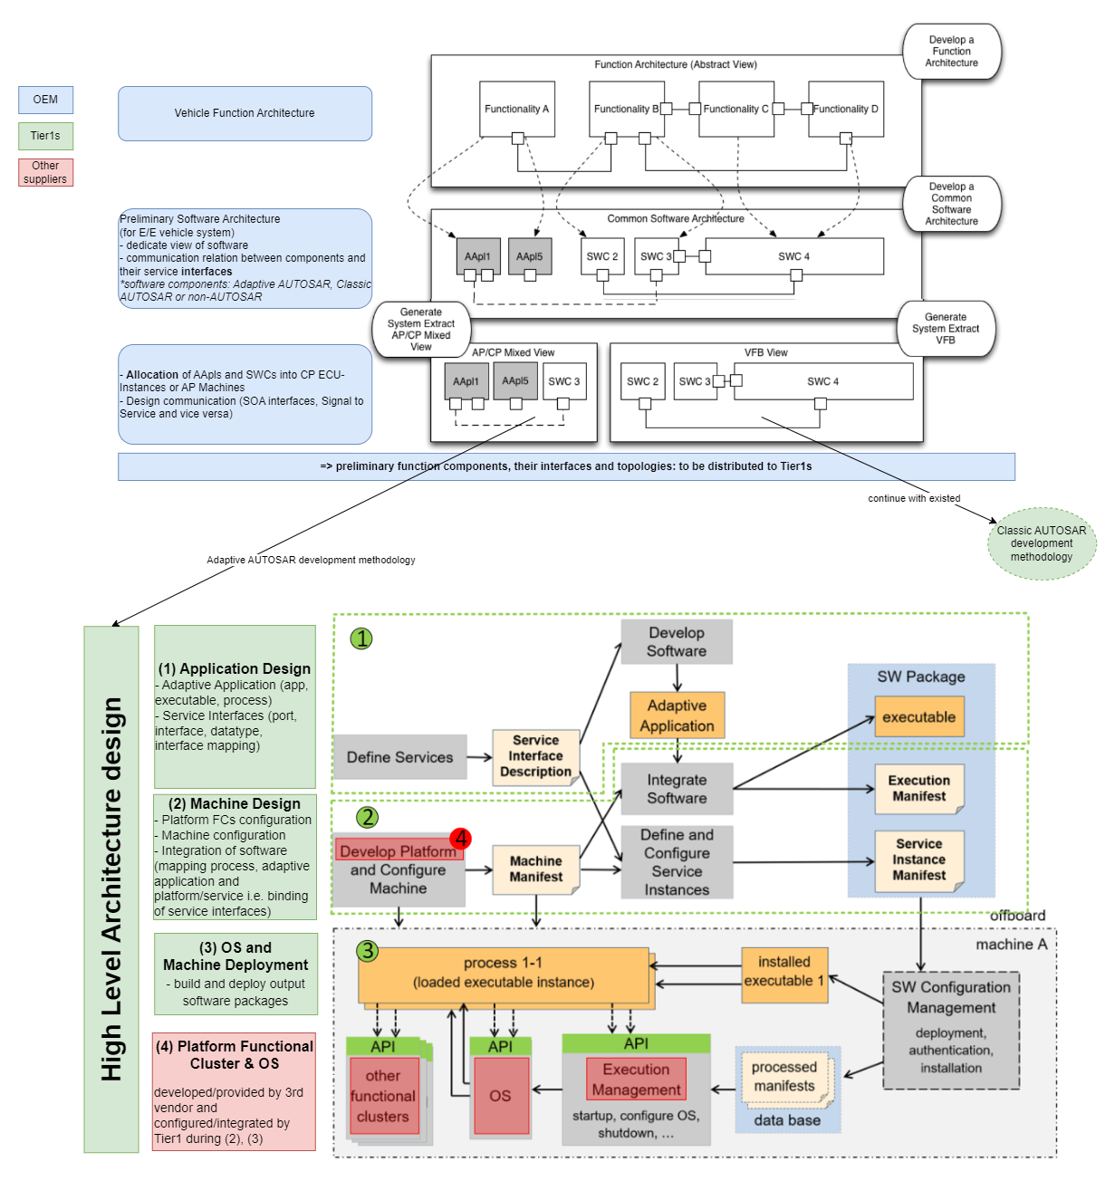
ADAPTIVE AUTOSAR Methedology

Slide 35
ADAPTIVE AUTOSAR Methedology
Above figure shows a generic top-down approach methodology of Adaptive AUTOSAR development. As we can see, the development methodology on the OEM level is pretty much the same as in Classic AUTOSAR.
The development methodology on ECU level is slightly different compare to Classic AUTOSAR in term of deployment. But the Adaptive Application development and Machine configuration/integration can be seen as the same as development activities in Classic AUTOSAR(Application SWCs and BSW configuration/integration).
corresponding output artifacts?
So what is the output artifacts from above development activities? (i.e. data exchange between involved parties in the development process).
Same as Classic AUTOSAR, Adaptive AUTOSAR also use arxml as a main medium to exchange/describe data/design such as: description of software, network topology, network communication,…

Slide 36
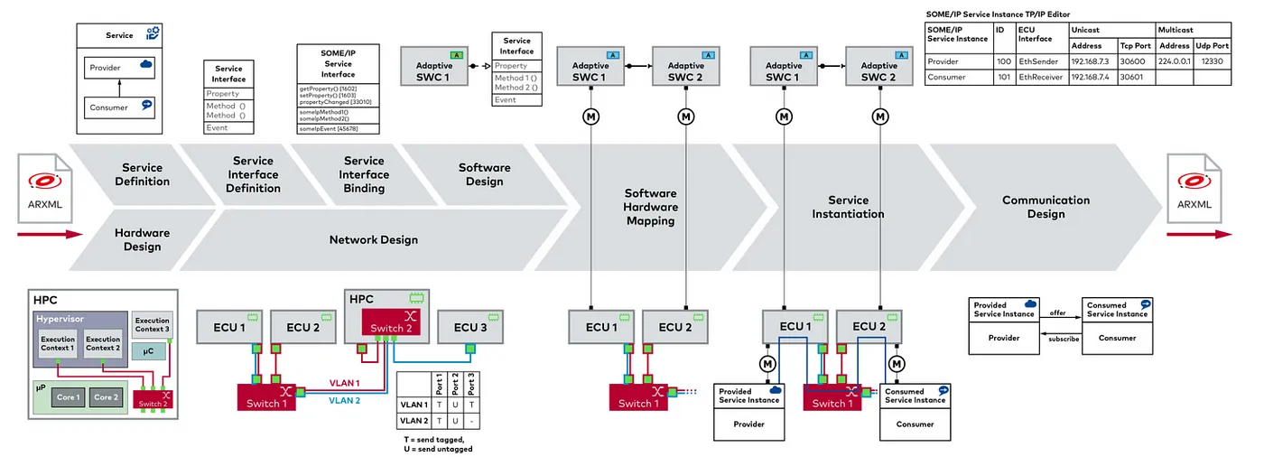
ADAPTIVE AUTOSAR Workflow
The workflow in Adaptive AUTOSAR is supported by tools and platforms that provide support for model-based development, configuration management, and testing. These tools include the AUTOSAR Builder, which allows for the creation and management of software components, and the AUTOSAR System Design Tool, which supports system architecture design and simulation.
The design workflow for AUTOSAR Adaptive: from Adaptive Service and Software Design to Network Topology and Machine Design and Ethernet Communication Design.

Slide 37
ADAPTIVE AUTOSAR Workflow
Modeling, System design, and implementation
Modeling, system design, and implementation are crucial stages in the development of Adaptive AUTOSAR systems. Here is an overview of these stages:
Modeling: Model-based development is a key feature of Adaptive AUTOSAR. At the modeling stage, software engineers use modeling tools such as Simulink, PREEvision, or SystemDesk to create models that describe the behavior and interactions of the system’s components. These models include functional requirements, software architecture, and communication interfaces between the components. The models are simulated and tested to ensure that they meet the system requirements and can be translated into code.
System design: Based on the models, the system architecture is designed. The architecture defines the components, their interactions, and the communication protocols between them. In Adaptive AUTOSAR, the system design is typically done using the AUTOSAR System Design Tool. The tool allows engineers to define the system architecture, allocate software components to hardware platforms, and define communication interfaces. The system design is validated using simulations and tests to ensure that it meets the system requirements.
Implementation: After the system design is completed and validated, the software components are implemented. The implementation involves translating the models into code using a code generator, such as the Embedded Coder tool. The code is then compiled, linked, and loaded onto the hardware platforms. The implementation stage also involves integration testing, which tests the interaction between the software components and verifies that the system meets the requirements.
Throughout the modeling, system design, and implementation stages, safety and security considerations are critical. Adaptive AUTOSAR provides features such as functional safety, cybersecurity, and secure communication to ensure that the system is safe and secure. The implementation stage also involves the verification of safety and security requirements, including the use of tools such as MISRA C and ISO 26262

Slide 38
ADAPTIVE AUTOSAR Components
Execution management, State management
Execution management and state management are important aspects of Adaptive AUTOSAR. Here is an overview of these concepts:
1. Execution management: Execution management in Adaptive AUTOSAR involves managing the execution of software components. Adaptive AUTOSAR supports two execution models: the event-driven model and the time-triggered model. In the event-driven model, software components are triggered by events such as inputs from sensors or user interactions. In the time-triggered model, software components are triggered at specific intervals. Adaptive AUTOSAR also supports mixed execution models, where some software components use the event-driven model, and others use the time-triggered model.
Execution management in Adaptive AUTOSAR is handled by the AUTOSAR Runtime Environment (RTE), which provides an abstraction layer between the software components and the hardware. The RTE manages the execution of the software components, ensuring that they run correctly and do not interfere with each other. The RTE also handles inter-component communication and manages the allocation of resources such as memory and CPU time.
2. State management: State management in Adaptive AUTOSAR involves managing the state of the system and the software components. The state of a system is the combination of all variables and parameters that define its current condition. In Adaptive AUTOSAR, software components can have different states, depending on their behavior and interaction with other components.
Adaptive AUTOSAR supports state management through a mechanism called the AUTOSAR State Manager. The State Manager is responsible for managing the state of the software components, ensuring that they are in the correct state at all times. The State Manager provides an interface that allows software components to query and set their state, as well as to receive notifications when the state changes.
Overall, execution management and state management are critical for ensuring the correct operation of Adaptive AUTOSAR systems. The AUTOSAR Runtime Environment and State Manager provide the necessary abstractions and mechanisms to handle these tasks efficiently and reliably.

Slide 39
ADAPTIVE AUTOSAR Components
Manifests: execution manifest, service instance, system design manifest, machine manifest
Manifests are used in Adaptive AUTOSAR to describe the configuration and behavior of the system and its components. Here are some of the different types of manifests used in Adaptive AUTOSAR:
Execution manifest: The execution manifest describes the configuration and behavior of the software components in the system. It includes information such as the component’s execution mode (event-driven, time-triggered, or mixed), the timing requirements for the component, and any dependencies on other components. The execution manifest is used by the AUTOSAR Runtime Environment to manage the execution of the software components.
Service instance manifest: The service instance manifest describes the configuration and behavior of a specific instance of a service. In Adaptive AUTOSAR, services are implemented as software components that provide specific functionality to other components in the system. The service instance manifest includes information such as the service’s input and output interfaces, the configuration parameters for the service, and any dependencies on other services or components.
System design manifest: The system design manifest describes the overall architecture of the system, including the allocation of software components to hardware platforms, the communication interfaces between the components, and any configuration parameters for the system as a whole. The system design manifest is used to generate the code for the system and to configure the hardware and software components.
Machine manifest: The machine manifest describes the configuration and behavior of the hardware platform on which the system is running. It includes information such as the CPU type, the memory size and layout, the input/output interfaces, and any configuration parameters for the hardware. The machine manifest is used to configure the hardware platform and to ensure that the software components are compatible with the hardware.
Overall, manifests are an important part of the configuration and management of Adaptive AUTOSAR systems. They provide a standardized way of describing the configuration and behavior of the system and its components, which can help to improve the reliability and maintainability of the system.

Slide 40
ADAPTIVE AUTOSAR Components
Communication in Adaptive Autosar platform (ara::com)
The adaptive AUTOSAR platform provides a communication middleware called ara::com for exchanging data and messages between software components in a distributed system. Here are some key features and concepts related to communication in ara::com:
Communication Interface: A communication interface defines the structure and behavior of the data exchanged between two software components. It includes data types, operations, and events. A software component can provide or require one or more communication interfaces.
Communication Layer: The communication layer handles the transmission and reception of data between components. It provides features such as message routing, protocol conversion, and reliability. The communication layer consists of a set of communication services and endpoints.
Communication Service: A communication service is a logical entity that provides a specific type of communication, such as TCP/IP or CAN. It includes configuration parameters and runtime state.
Communication Endpoint: A communication endpoint represents a connection point for a communication service. It has a unique identifier and can be configured with endpoint properties such as network address and port number.
Communication Matrix: The communication matrix is a configuration file that defines the communication relationships between software components. It specifies which communication interfaces are provided and required by each component, and how they are connected to communication endpoints.
Communication Handler: The communication handler is responsible for managing the communication between software components based on the communication matrix. It handles message routing, protocol conversion, and error handling.
Overall, ara::com provides flexible and configurable communication middleware for adaptive AUTOSAR platforms. It enables software components to exchange data and messages in a reliable and efficient manner, using different communication services and protocols.

Slide 41
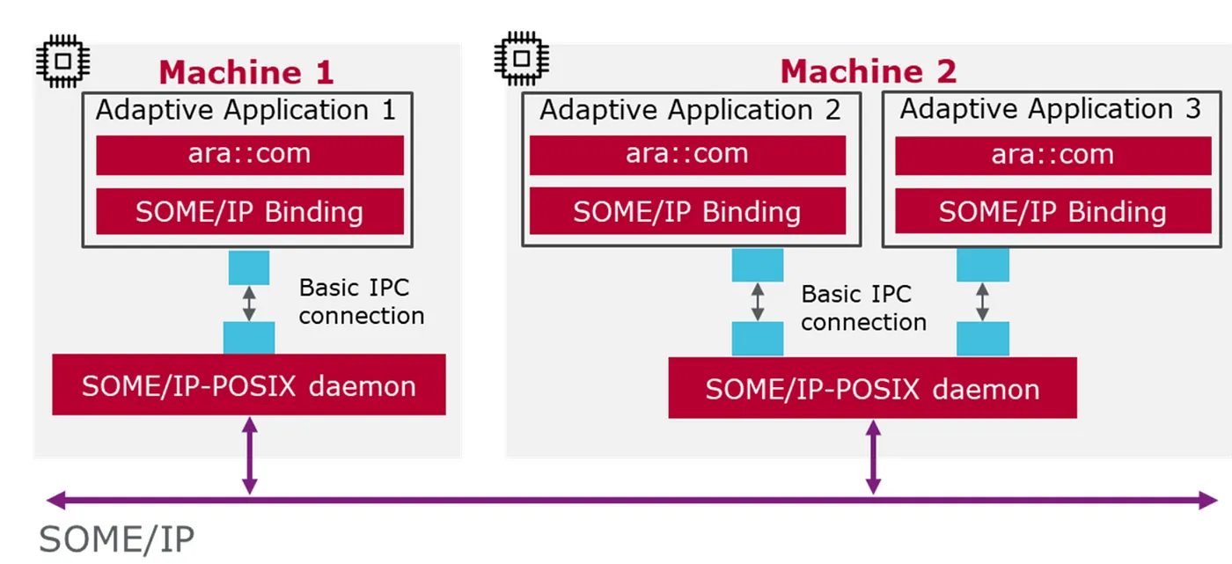
ADAPTIVE AUTOSAR Components
Service-oriented architecture and protocols
Service Oriented Architecture (SOA) is an architectural pattern that promotes the use of loosely coupled, modular services for building complex software systems. Adaptive AUTOSAR platform supports the SOA pattern and provides a set of communication protocols for implementing it. Here are some of the protocols used in adaptive AUTOSAR for implementing SOA:
Remote Procedure Call (RPC): RPC is a protocol that allows a client to call a procedure on a remote server and receive the results. It is used for synchronous communication between software components in adaptive AUTOSAR. The AUTOSAR RPC protocol is a standardized protocol for implementing RPC in adaptive AUTOSAR.
Data Distribution Service (DDS): DDS is a protocol that enables real-time data sharing between distributed systems. It is used for asynchronous communication between software components in adaptive AUTOSAR. The AUTOSAR DDS protocol is a standardized protocol for implementing DDS in adaptive AUTOSAR.
Ethernet: Ethernet is a widely used networking protocol that provides a reliable and efficient communication medium for distributed systems. It is used for both synchronous and asynchronous communication between software components in adaptive AUTOSAR. The AUTOSAR Ethernet protocol is a standardized protocol for implementing Ethernet in adaptive AUTOSAR.
CAN: CAN is a protocol that is widely used in the automotive industry for communication between electronic control units (ECUs). It is used for both synchronous and asynchronous communication between software components in adaptive AUTOSAR. The AUTOSAR CAN protocol is a standardized protocol for implementing CAN in adaptive AUTOSAR.

Slide 42
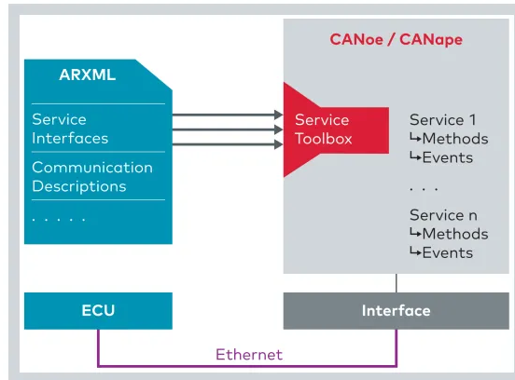
ADAPTIVE AUTOSAR Components
Service interface: methods/events/fields
In Adaptive AUTOSAR, a service interface defines the structure and behavior of the data and messages exchanged between software components. Here’s how methods, events, and fields are defined in the context of Adaptive AUTOSAR:
Methods: In Adaptive AUTOSAR, methods are called operations, and they represent the functions that a software component provides or requires. An operation has a name, a set of input parameters, a set of output parameters, and a return value (if any). Operations can be synchronous or asynchronous, and they are defined in the service interface of a software component.
Events: Events represent asynchronous notifications that a software component can send or receive. They are defined in the service interface of a software component and can be subscribed to by other components. Events have a name and a set of parameters, which describe the data associated with the event.
Fields: Fields represent the data elements that are exchanged between software components. They are defined in the data types that are used by the service interface. Fields can have different types, such as integers, floats, strings, or structured types, and they can be optional or mandatory.
Overall, the service interface in Adaptive AUTOSAR defines the structure and behavior of the communication between software components. It includes operations, events, and fields, which together define the data and messages exchanged between components.

Slide 43
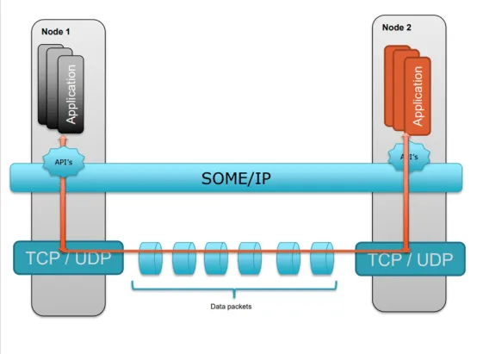
ADAPTIVE AUTOSAR Components
SOME/IP
SOME/IP (Scalable service-Oriented MiddlewarE over IP) is a communication protocol used in Adaptive AUTOSAR (Automotive Open System ARchitecture) for inter-ECU (Electronic Control Unit) communication in a vehicle.
Adaptive AUTOSAR is a software architecture for developing scalable and flexible automotive software systems. It supports dynamic software updates, flexible hardware configurations, and integration with external services. In such a system, multiple ECUs can communicate with each other over the network, and SOME/IP provides a standardized and efficient way of doing this.
SOME/IP is based on the IP (Internet Protocol) stack and uses UDP (User Datagram Protocol) for data transfer. It supports service-oriented communication, where each ECU provides a set of services that can be accessed by other ECUs. It also supports different types of service discovery mechanisms, such as multicast and unicast, which allow ECUs to discover and communicate with each other dynamically.
One of the advantages of SOME/IP is its scalability, which allows it to be used in both small and large-scale automotive systems. It also supports efficient data transfer and provides mechanisms for error handling and data fragmentation.
In summary, SOME/IP is an important communication protocol used in Adaptive AUTOSAR for enabling inter-ECU communication in modern automotive systems.

Slide 44
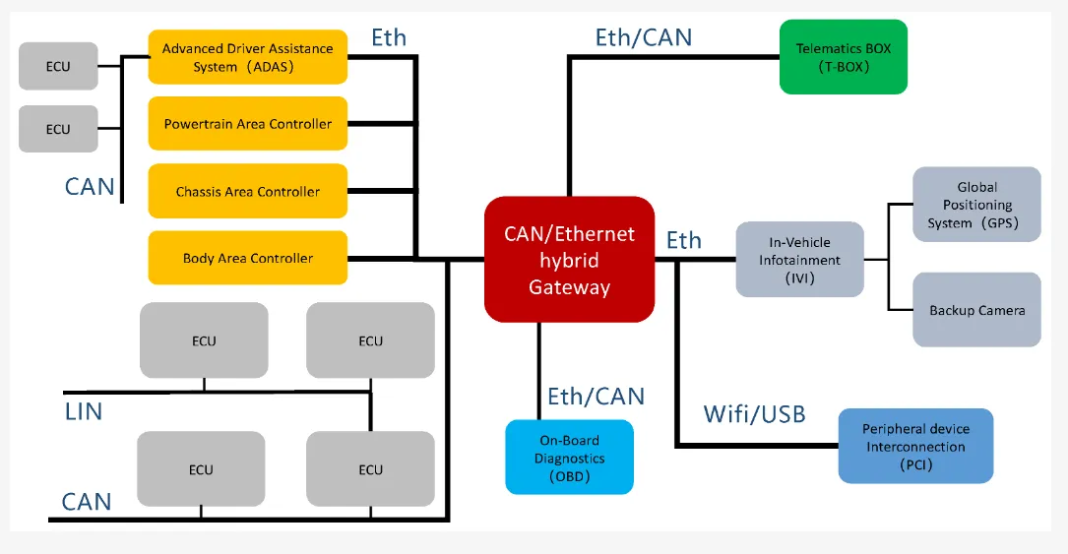
ADAPTIVE AUTOSAR Components
Communication management
Communication management is an important aspect of Adaptive AUTOSAR (Automotive Open System ARchitecture) since it enables the communication between different software components and ECUs (Electronic Control Units) in a vehicle. In Adaptive AUTOSAR, the communication management module is responsible for managing communication between ECUs and different software components within the vehicle.
The communication management module provides an interface between the application layer and the underlying communication protocol stack. It supports various communication protocols such as SOME/IP, CAN (Controller Area Network), and Ethernet, depending on the specific use case and requirements.
The communication management module also handles communication-related events such as data transmission and reception, error handling, and communication timeouts. It provides an abstraction layer that shields the application layer from the underlying communication protocol details and allows for a more modular and flexible design of the software architecture.

Slide 45
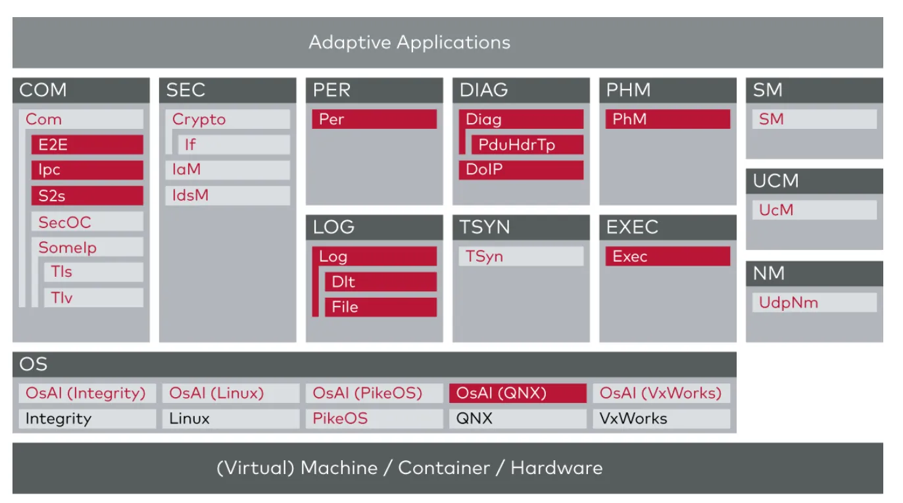
ADAPTIVE AUTOSAR Components
To ensure efficient communication management in Adaptive AUTOSAR, the communication management module typically includes various features such as:
Service-oriented communication, which allows different software components and ECUs to provide and access services through a standardized interface.
Service discovery mechanisms that enable ECUs to discover and communicate with each other dynamically.
Efficient message transfer protocols such as SOME/IP and CAN that provide reliable and fast data transfer between ECUs.
Diagnostics and monitoring capabilities that allow for the detection and resolution of communication-related issues.
In summary, communication management is a critical aspect of Adaptive AUTOSAR, and the communication management module plays a central role in enabling efficient communication between different software components and ECUs in a vehicle.

Slide 46
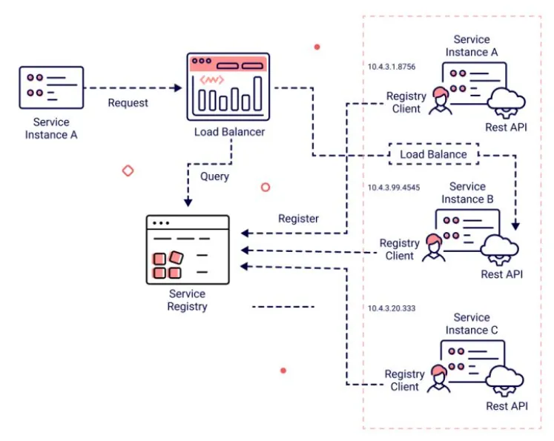
ADAPTIVE AUTOSAR Components
Service Discovery
Service discovery is an important aspect of adaptive AUTOSAR. Adaptive AUTOSAR is designed to support the dynamic configuration and scaling of software systems in response to changing conditions, such as the availability of new services or changes in resource availability.
In adaptive AUTOSAR, service discovery refers to the process of identifying and locating available services within the system or environment. This is typically achieved through the use of service registries or service discovery mechanisms, such as multicast Domain Name System (mDNS) or Simple Service Discovery Protocol (SSDP).
Once services have been discovered, adaptive AUTOSAR can dynamically adjust the configuration and scaling of the system in response to changes in demand or availability. For example, if a new service is added to the system, adaptive AUTOSAR can automatically update the configuration to ensure that the new service is available to other components that require it. Similarly, if there is a sudden increase in demand for a particular service, adaptive AUTOSAR can scale up the number of instances of that service to ensure that it can handle the increased load.
Overall, service discovery is a key enabler of the dynamic configuration and scaling capabilities of adaptive AUTOSAR, allowing the system to respond quickly and effectively to changing conditions in the environment.

Slide 47
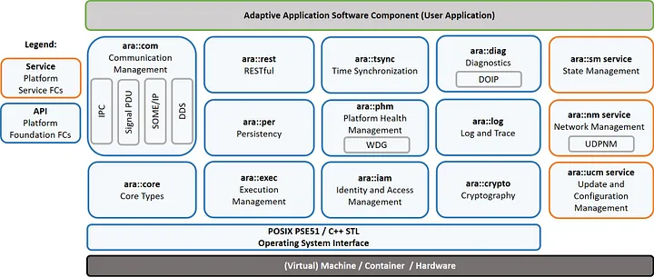
ADAPTIVE AUTOSAR Components
M4: Functional clusters
Functional clusters are a key concept in adaptive AUTOSAR. In this context, a functional cluster refers to a group of AUTOSAR software components that are responsible for providing a specific set of functionality within the system.
Functional clusters in adaptive AUTOSAR are designed to be highly modular and flexible, allowing different clusters to be combined and configured in different ways to meet the needs of different applications and use cases. Each functional cluster is designed to be self-contained, with well-defined interfaces and APIs that allow it to interact with other clusters and components in the system.
Some common examples of functional clusters in adaptive AUTOSAR include:
Communication clusters: These clusters are responsible for managing the communication between different components in the system, and may include protocols such as Ethernet, CAN, and FlexRay.
Security clusters: These clusters are responsible for providing security-related functionality, such as authentication, encryption, and access control.
Sensor and actuator clusters: These clusters are responsible for managing the inputs and outputs of the system, and may include components such as sensors, actuators, and signal processing modules.
Control and decision-making clusters: These clusters are responsible for providing high-level decision-making and control functionality, and may include components such as controllers, planners, and state machines.
Overall, functional clusters are a key enabler of the modular, flexible, and adaptive nature of AUTOSAR systems, allowing them to be customized and configured in a highly granular way to meet the needs of different applications and use cases.

Slide 48
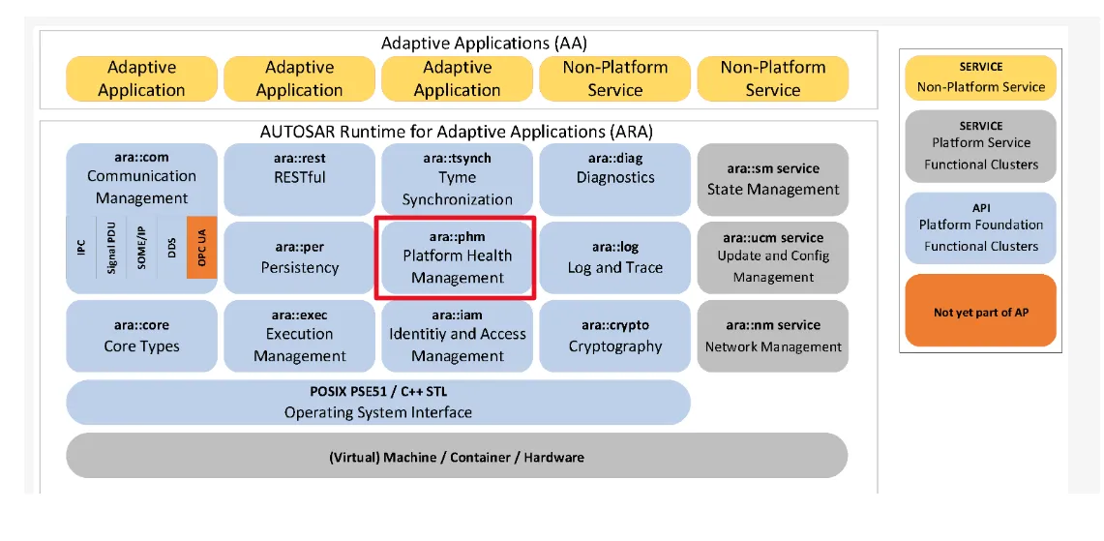
ADAPTIVE AUTOSAR Components
Platform Health Management
Platform Health Management (PHM) is an important aspect of Adaptive AUTOSAR that deals with the diagnosis, detection, and management of faults or failures in the system. In this context, the “platform” refers to the underlying hardware and software infrastructure that supports the Adaptive AUTOSAR system.
PHM in Adaptive AUTOSAR includes a range of techniques and tools for monitoring the health of the platform, identifying potential issues, and responding to faults or failures in a timely and effective manner. This can include techniques such as predictive maintenance, fault detection and isolation, and performance monitoring.
One of the key benefits of PHM in Adaptive AUTOSAR is that it allows the system to operate more reliably and efficiently, by minimizing the impact of faults or failures on system performance and availability. PHM can also help to reduce maintenance costs and downtime, by allowing issues to be detected and addressed before they become critical.
Examples of PHM techniques in Adaptive AUTOSAR may include:
Sensor data monitoring: This involves monitoring sensor data from various system components to detect anomalies or changes in performance that may indicate a fault or failure.
Fault detection and isolation: This involves using algorithms and models to detect faults or failures in the system, and isolate the affected components to prevent the issue from spreading.
Predictive maintenance: This involves using data analytics and machine learning techniques to predict when maintenance or repairs may be required, based on factors such as system usage patterns and component lifetimes.

Slide 49
ADAPTIVE AUTOSAR Components
Update and Configuration Management
Update and Configuration Management (UCM) is an important aspect of Adaptive AUTOSAR that deals with the management of updates and configuration changes to the software components and systems in the AUTOSAR environment.
UCM in Adaptive AUTOSAR includes a range of techniques and tools for managing software updates, configurations, and versioning. This can include techniques such as delta updates, binary patching, and over-the-air (OTA) updates.
One of the key benefits of UCM in Adaptive AUTOSAR is that it allows the system to be updated and configured in a flexible and efficient manner, without the need for manual intervention or downtime. UCM can also help to reduce the risk of errors or conflicts that may arise when making changes to complex systems.
Examples of UCM techniques in Adaptive AUTOSAR may include:
Delta updates: This involves updating only the changes that have been made to a software component, rather than replacing the entire component.
Binary patching: This involves applying a patch to a software component, to fix a specific issue or add new functionality.
Over-the-air (OTA) updates: This involves updating software components over a wireless network, allowing updates to be distributed and installed remotely.
Overall, UCM is a critical aspect of Adaptive AUTOSAR that helps to ensure the efficient and flexible management of software updates and configurations in the AUTOSAR environment. By enabling updates and configuration changes to be made quickly and easily, UCM can help to improve system reliability, performance, and security.

Slide 50
ADAPTIVE AUTOSAR Components
Diagnostics and Persistency Management
In Adaptive AUTOSAR, diagnostics, and persistency management are important features that enable the system to detect and recover from faults, as well as preserve important data even in the event of a system failure. Here is an overview of these two features:
Diagnostics: Diagnostics in Adaptive AUTOSAR refers to the process of monitoring the system for faults and errors. It involves detecting, isolating, and identifying faults that occur within the system, as well as providing information to the user about the status of the system. This information can be used to diagnose problems, identify their root causes, and take corrective action to address them.
In Adaptive AUTOSAR, the diagnostics system is composed of several components, including the diagnostic manager, the diagnostic monitor, and the diagnostic communication manager. These components work together to ensure that the system is continuously monitored for faults and errors. If a fault is detected, the system can take corrective action to address the issue, such as shutting down a component or providing a warning to the user.
Persistency Management: Persistency management in Adaptive AUTOSAR refers to the ability of the system to store and retrieve data even in the event of a system failure. This is important for preserving critical data and ensuring that the system can quickly recover from a failure. In Adaptive AUTOSAR, persistency management is implemented using non-volatile memory (NVM), which allows data to be stored even when the system is powered off.
The persistency management system in Adaptive AUTOSAR is composed of several components, including the NVM manager, the NVM block driver, and the NVM service. These components work together to ensure that data is stored in a way that is safe and reliable, and that it can be quickly retrieved in the event of a failure.
Overall, diagnostics and persistency management are important features in Adaptive AUTOSAR that enable the system to detect and recover from faults, as well as preserve critical data in the event of a system failure. By incorporating these features into the system design, developers can create more robust and reliable Adaptive AUTOSAR systems.

Slide 51
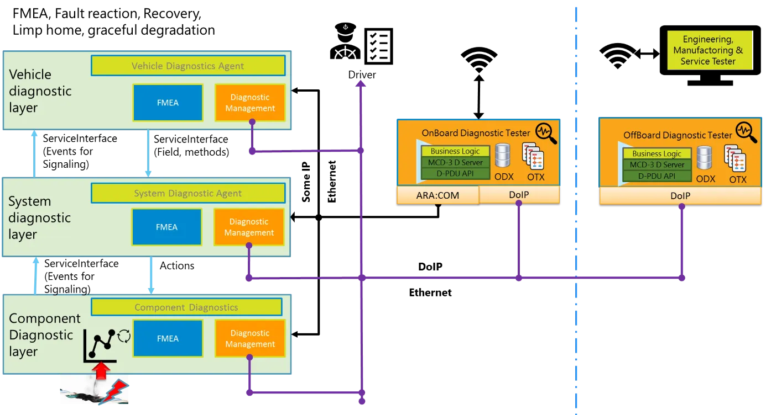
ADAPTIVE AUTOSAR Components

Slide 52
ADAPTIVE AUTOSAR Components
Synchronization
Synchronization in Adaptive AUTOSAR refers to the coordination of different software components and their interactions within the system. This is important because, in a complex system, there may be many different software components running simultaneously, each with its own set of requirements and constraints. Synchronization helps to ensure that these components work together harmoniously and that they do not interfere with one another.
There are several mechanisms that can be used to achieve synchronization in Adaptive AUTOSAR:
Event-Based Communication: Event-based communication is a messaging mechanism that allows software components to send and receive messages based on predefined events. For example, a component may send a message to indicate that a certain event has occurred, such as the completion of a task. Other components can then receive this message and take appropriate action based on the information provided.
Time-Based Synchronization: Time-based synchronization involves using a clock to synchronize the activities of different components. This can be useful in systems where different components need to be activated at specific times or intervals. For example, in a real-time system, certain components may need to be activated at specific intervals to ensure that the system operates correctly.
Mutexes and Semaphores: Mutexes and semaphores are synchronization mechanisms that prevent multiple components from accessing a shared resource simultaneously. A mutex is a locking mechanism that allows only one component to access a shared resource at a time, while a semaphore is a signaling mechanism that allows multiple components to access a shared resource in a controlled manner.
State-Based Synchronization: State-based synchronization involves coordinating the activities of different components based on their current state. For example, a component may need to wait until another component has completed a task before it can proceed. In this case, the first component can monitor the state of the second component and only proceed when the state changes to a specific value.
Overall, synchronization is an important aspect of Adaptive AUTOSAR because it helps to ensure that different software components work together harmoniously and that the system operates correctly. By using the appropriate synchronization mechanisms, developers can create more robust and reliable systems that can meet the requirements of complex and demanding applications.

Slide 53
ADAPTIVE AUTOSAR Note
Note Adaptive AUTOSAR is a software architecture that provides a standardized framework for developing software for automotive electronic control units (ECUs). It aims to address the increasing complexity of modern vehicles by allowing for more flexible and efficient software development, as well as enabling over-the-air updates and other advanced features. In conclusion, Adaptive AUTOSAR has the potential to revolutionize the automotive industry by enabling faster and more efficient software development, greater flexibility and scalability, and enhanced functionality. However, it also requires significant investment and expertise to implement effectively, and there are still some challenges to be overcome, such as ensuring compatibility with legacy systems and addressing security concerns. Overall, Adaptive AUTOSAR is a promising technology that is likely to play an increasingly important role in the future of the automotive industry.
applications of AUTOSAR:
Vehicle control: AUTOSAR can be used to develop software for a wide range of vehicle control systems, such as engine management, transmission control, braking, steering, and suspension.
Infotainment: AUTOSAR can be used to develop software for in-vehicle entertainment systems, such as audio and video playback, navigation, and connectivity.
Safety-critical systems: AUTOSAR is used to develop software for safety-critical systems, such as anti-lock braking systems (ABS), electronic stability control (ESC), and airbag systems.
Advanced driver assistance systems (ADAS): AUTOSAR can be used to develop software for ADAS features, such as adaptive cruise control, lane departure warning, and automatic emergency braking.
Over-the-air updates: AUTOSAR can be used to implement over-the-air software updates, which enable manufacturers to remotely update the software in a vehicle’s ECUs without requiring a physical visit to the dealership.
Diagnostic systems: AUTOSAR can be used to develop software for on-board diagnostic (OBD) systems, which are used to diagnose and monitor the performance of a vehicle’s various systems and components.
Overall, AUTOSAR is a versatile software architecture that can be used to develop software for a wide range of automotive applications, from basic control systems to advanced driver assistance systems and beyond.

Slide 54
ADAPTIVE AUTOSAR Note
Why Adaptive AUTOSAR:
Increasingly computing power provide by embedded processor both in term of processor core computing power and number of cores. Adoption of Automotive Ethernet introduce larger communication bandwidth.
Increase in highly complex functionalities, and demand for a more dynamic, flexibility of vehicle architecture.
⟹ Adaptive AUTOSAR is introduced to address these necessity(V2X communication, computing power, complex functions, scalability, upgradeability), not to replace the existed Classic AUTOSAR(safety critical actuator function) or other Non-AUTOSAR-IVI/COST but to interact with existed vehicle system and other infrastructures outside of vehicle.
Adaptive AUTOSAR use C++ 14 standard, service oriented architecture, it offer flexibility during development and deployment at running, but still dynamic behavior of the system can be limited/restricted by system integrator via Execution Manifest (planned dynamic).
Example of reduced behavioral dynamics (communication, memory, execution & timing):
Pre-determination of the service discovery process
Restriction of dynamic memory allocation to the startup phase only
Fair scheduling policy in addition to priority-based scheduling
Fixed allocation of processes to CPU cores
Access to pre-existing files in the file-system only
Constraints for AUTOSAR Adaptive Platform API usage by applications
Execution of authenticated code only

Slide 55
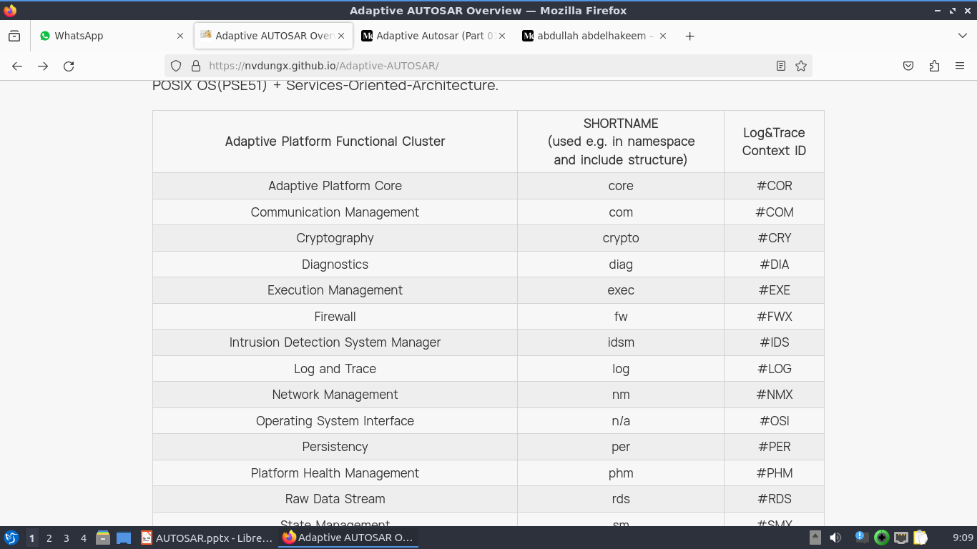
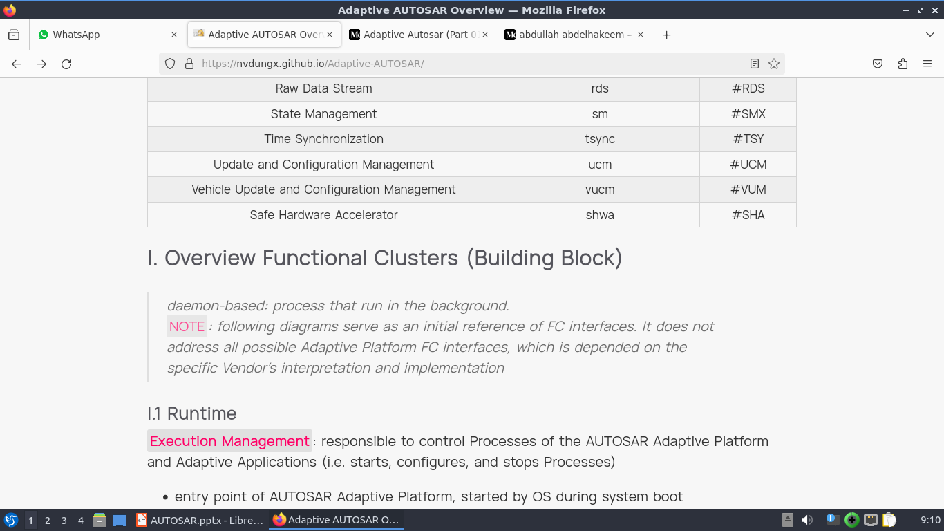
ADAPTIVE AUTOSAR Concepts
⟹ SUMMARY: Adaptive AUTOSAR = High performance/multi-core SoC + Automotive Ethernet + POSIX OS(PSE51) + Services-Oriented-Architecture.

Slide 56
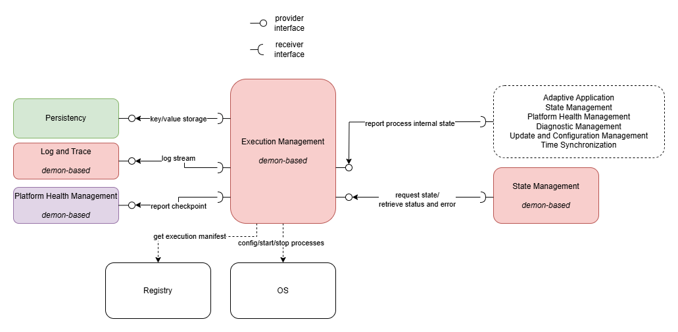
Concepts:Execution mgmt
ADAPTIVE AUTOSAR
I. Overview Functional Clusters (Building Block)
daemon-based: process that run in the background.
NOTE: following diagrams serve as an initial reference of FC interfaces. It does not address all possible Adaptive Platform FC interfaces, which is depended on the specific Vendor’s interpretation and implementation
I.1 Runtime
Execution Management: responsible to control Processes of the AUTOSAR Adaptive Platform and Adaptive Applications (i.e. starts, configures, and stops Processes)
entry point of AUTOSAR Adaptive Platform, started by OS during system boot
control startup/shutdown of AUTOSAR Adaptive Platform
configure process resource (CPU time, memory) base on Manifest
optionally support authenticated boot

Slide 57
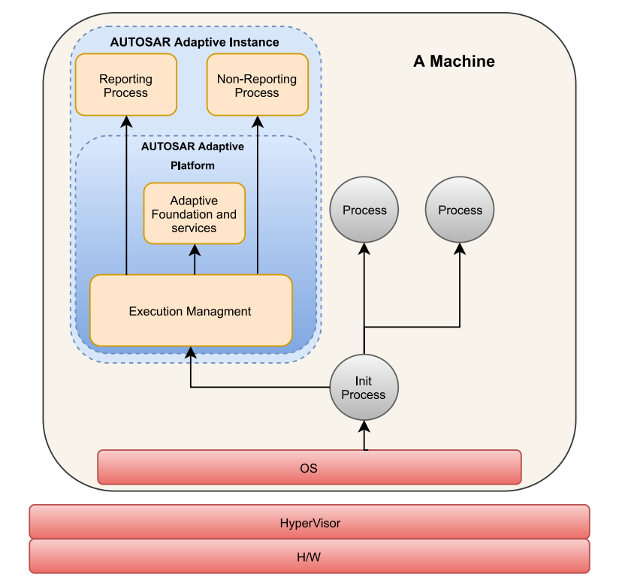
Concepts:Execution mgmt
ADAPTIVE AUTOSAR
Startup sequence: OS or hypervisor initialize then start the Execution Management as the 1st Adaptive AUTOSAR process ⟹ EXEC then start other FCs or AAs according to Manifest, authentication boot shall be performed as well and started processes state shall be notified to PHM for follow-up supervising activities.
Machine Functional Group(FG) State: group of processes(Adaptive Platform FC, Adaptive Application) available at certain Machine State (.e.g Startup, Running, Shutdown)
FG State: group of processes available at requested FG State by State Management (.e.g Startup, Driving, Restart, Parking,…)
Process/Execution State: state of process (.e.g. Initializing, Running, Terminating)

Slide 58
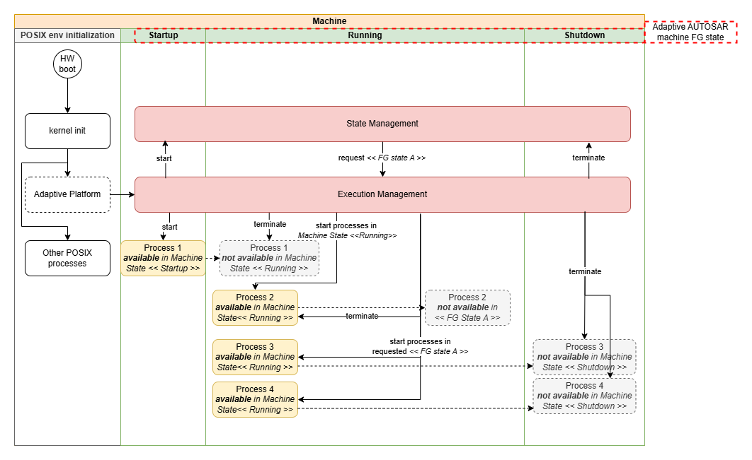
Concepts:Startup seq
ADAPTIVE AUTOSAR

Slide 59
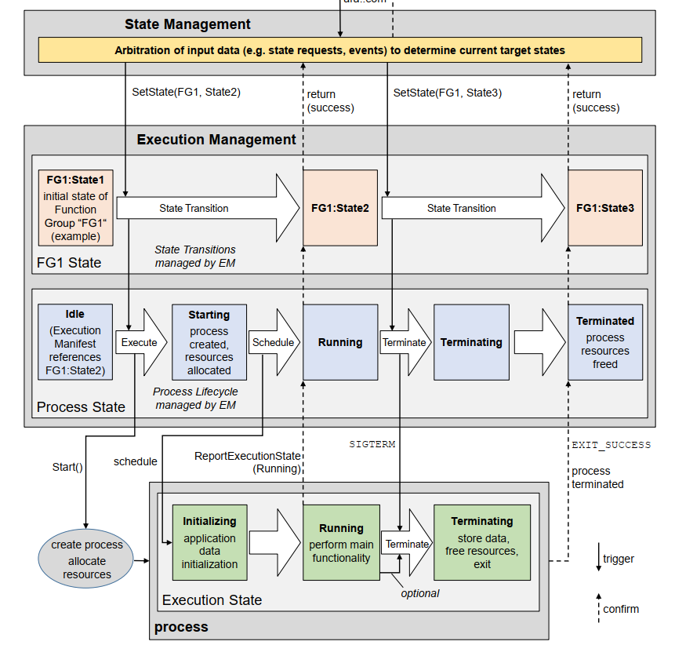
Concepts:Startup seq
ADAPTIVE AUTOSAR

Slide 60
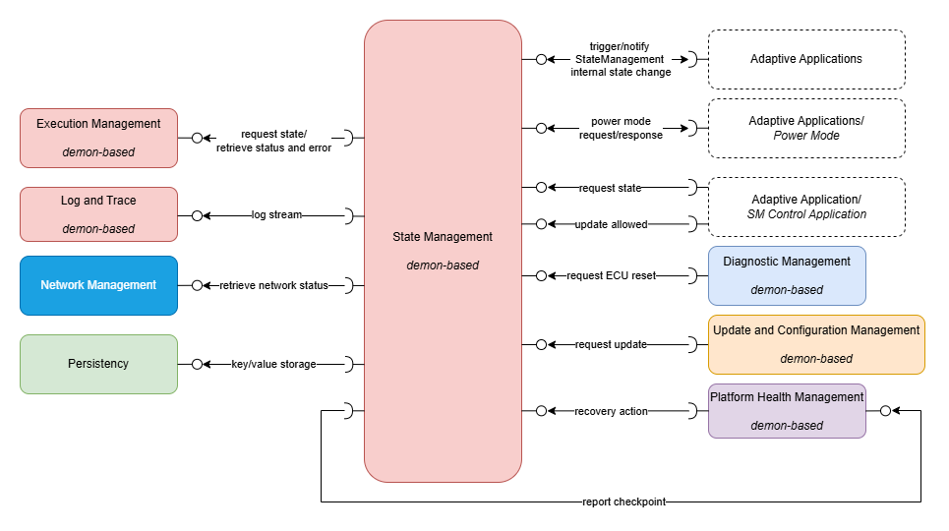
Concepts:state mgmt
ADAPTIVE AUTOSAR
State Management: based on various application-specific inputs, determines the desired target state of the Adaptive Applications
state management operation is application-specific
the state control action is delegated to Execution Management (i.e. state = set of active Function Group State)

Slide 61
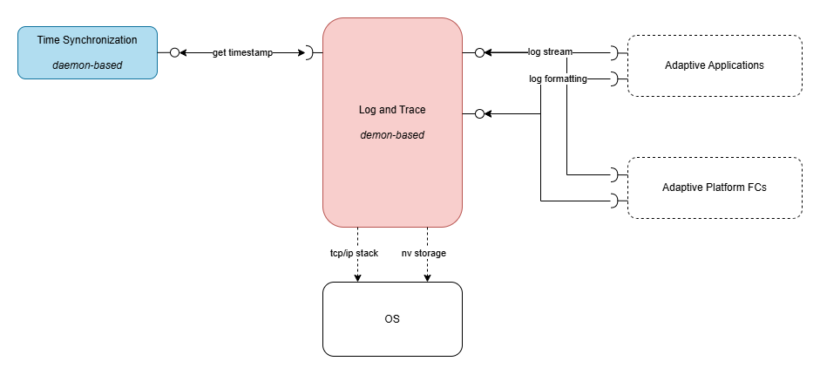
Concepts:log-trace
ADAPTIVE AUTOSAR
Log and Trace: provides functionality to build and log messages of different severity to different sinks(e.g. network, a serial bus, the console, and to non-volatile storage).
provide log stream for different severity level
configurable output format and sinks

Slide 62
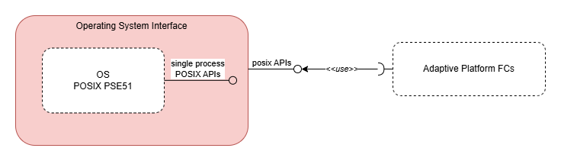
Concepts:Core -OS
ADAPTIVE AUTOSAR
Adaptive Platform Core: provide functionality for initialization and de-initialization of the AUTOSAR Runtime for Adaptive Applications as well as termination of Processes.
defines set of common data types used by multiple Functional Clusters as part of their public interfaces.
provides global initialization and shutdown functions that initialize respectively de-initialize data structures and threads of the AUTOSAR Runtime for Adaptive Applications.
general error handling, operation for abnormal termination of processes.
Operating System Interface: provide functionality for implementing multi-threaded real-time embedded applications and corresponds to the POSIX PSE51 profile

Slide 63
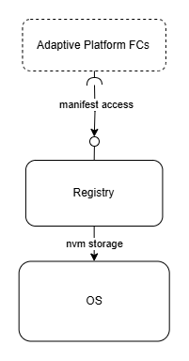
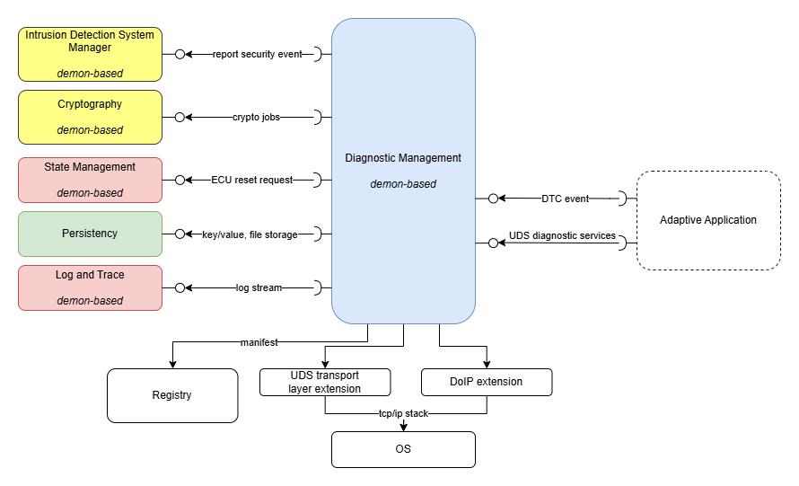
Concepts:
ADAPTIVE AUTOSAR
Registry: provides access information stored in the Manifest(json file structure), intended to be used by Platform FCs only.
Diagnostic Management: responsible for handling diagnostic functionalities.
manage diagnostic events produced by the individual Processes.
provides access to diagnostic data for external Diagnostic Clients via standardized network protocols (ISO 14229, 13400).

Slide 64
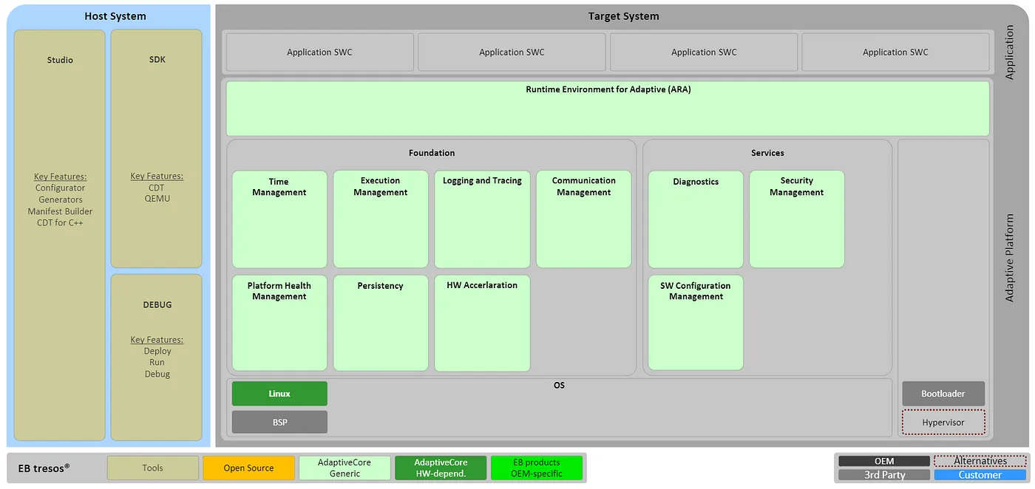
Concepts:Core
ADAPTIVE AUTOSAR

Slide 65
Concepts:Core
ADAPTIVE AUTOSAR

